Slide 1
Microsoft Power BI

Slide 2
Modern React-JS Development with Power BI Embedding
Ted Pattison
Principal Program Manager
Power BI Customer Advisory Team (PBICAT)

Slide 3
Agenda
Modern React Primer
Building a User Interface using Material UI
Authenticating Users with MSAL
Calling the Power BI REST API
Managing Application State using Context

Slide 4
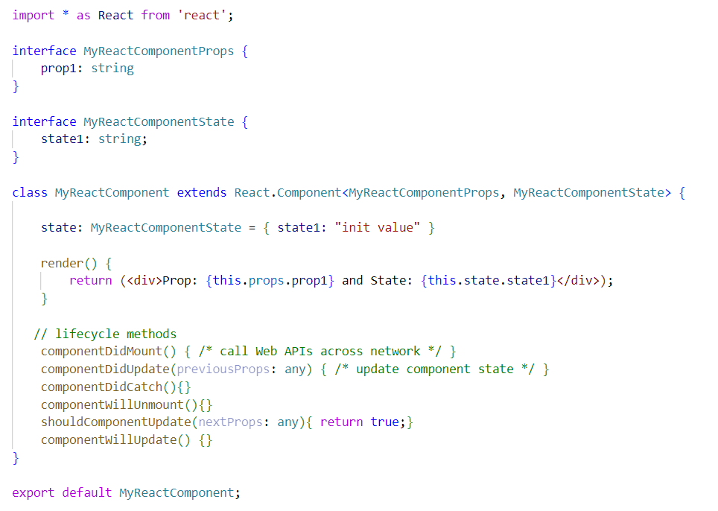
Migrating from Classic React to Modern React
Classic React based on class-based components and lifecycle method
Modern React based on functional components and hooks
Class React with Class-based Components
Modern React with Functional Components

Slide 5
Hooks – a few quick examples
Hooks provided by React
useState
useEffect
useLayoutEffect
useContext
Hooks provided by Microsoft Authentication Library for React
useIsAuthenticated
useAccount

Slide 6
Getting Started with Hooks - useState
Component state tracked using useState hook
Only call hooks like useState at the top level of your components – do not nest these calls!
useState returns array with state value (message) and state modifier method (setMessage)
State value (message) can be used anywhere in component
Calling state modifier method (setMessage) in event handler triggers re-render
Calling state modifier method (setMessage) during rendering causes recursion – don’t do it!

Slide 7
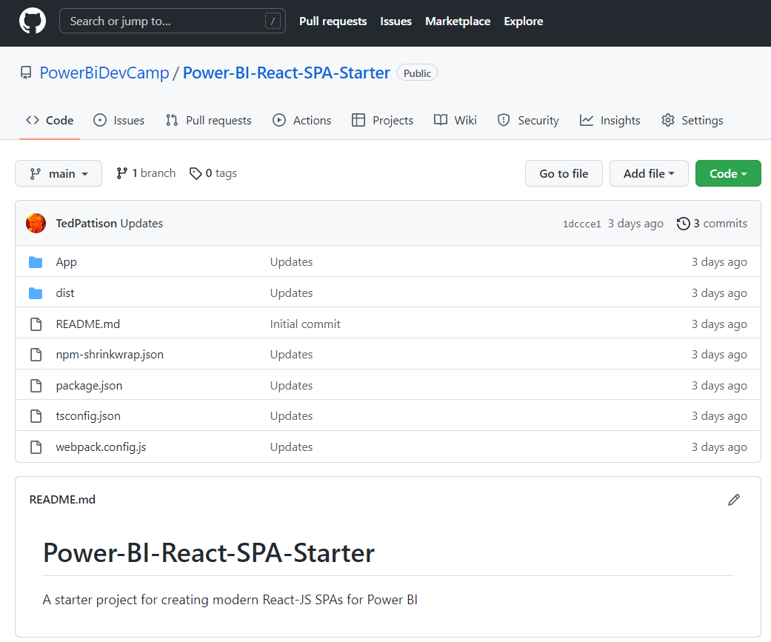
GitHub Repository: Power-BI-React-SPA-Starter
Demo code from this session available in public GitHub repository
https://github.com/PowerBiDevCamp/Power-BI-React-SPA-Starter

Slide 8
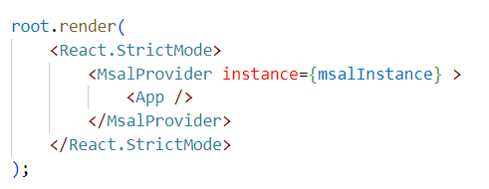
Top-level Component Hierarchy
Support for MSAL, CssBaseline and React Router
index.tsc
app.tsc
pagelayout.tsc

Slide 11
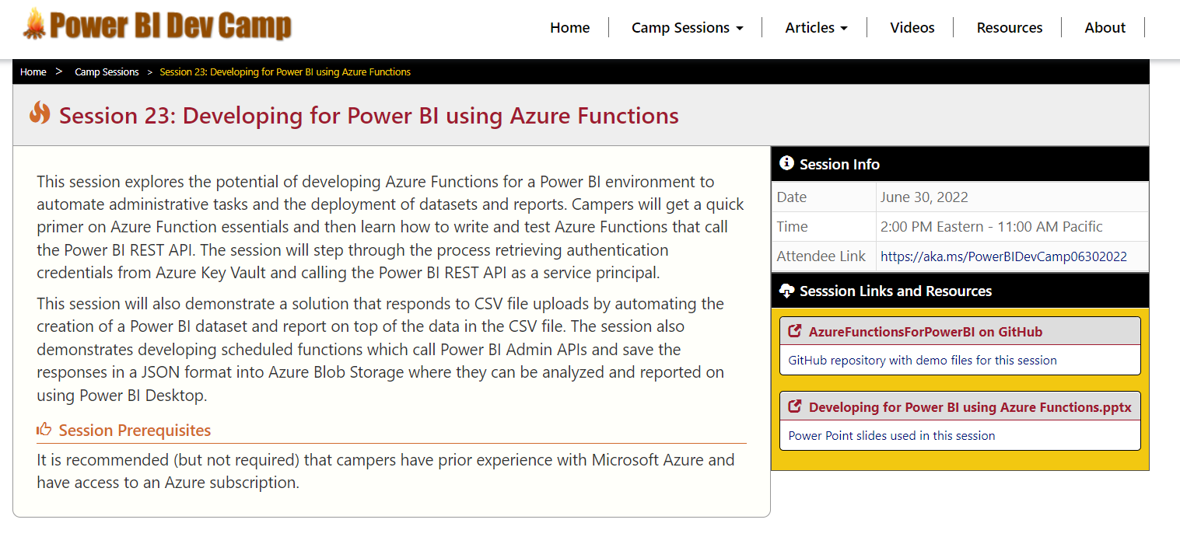
Welcome to Power BI Dev Camp
Power BI Dev Camp Portal - https://powerbidevcamp.net

Slide 12
GitHub Repository: ModernReactForPowerBI
Demo code from this session available in public GitHub repository
https://github.com/PowerBiDevCamp/ ModernReactForPowerBI

Slide 13
Modern React – Essential Concepts
What’s wrong with the classic React programming model?
Class-based components and lifecycle methods adds complexity even in simple scenarios
Easy to introduce bugs when implementing lifecycle methods
Moving to the modern React-JS programming model
Functional components replace class-based components
Hooks replace classic React state management and lifecycle methods
Class React with Class-based Components
Modern React with Functional Components

Slide 14
Hooks – a few quick examples
Hooks provided by React
useState
useEffect
useLayoutEffect
useContext
Hooks provided by Microsoft Authentication Library for React
useIsAuthenticated
useAccount

Slide 15
Getting Started with Hooks - useState
Component state tracked using useState hook
Only call hooks like useState at the top level of your components – do not nest these calls!
useState returns array with state value (message) and state modifier method (setMessage)
State value (message) can be used anywhere in component
Calling state modifier method (setMessage) in event handler triggers re-render
Calling state modifier method (setMessage) during rendering causes recursion – don’t do it!

Slide 16
Migrating from Classic React to Modern React
Classic React based on class-based components and lifecycle method
Modern React based on functional components and hooks
Class React with Class-based Components
Modern React with Functional Components

Slide 17
Writing Pure Functions without Side Effects
Functional components should be written without side effects
Function return value is only determined by its input values
Function should not change any values during its execution
Function always returns same output value for the same input values
Pure functions only perform a calculation and nothing more
Pure functions allow to avoid baffling bugs and unpredictable behavior
Pure function minds its own business
It does not change props, state or context while rendering
Same inputs, same output
Given the same inputs, a pure function should always return the same result.

Slide 18
Understanding the PowerBI-React-SPA-Starter Project
NPM Package Support
React & React Router
Material UI
MSAL & MSAL React
TypeScript
Webpack

Slide 19
Top-level Component Hierarchy
Support for MSAL, CssBaseline and React Router
index.tsc
app.tsc
pagelayout.tsc

Slide 20
Agenda
Modern React Primer
Building a User Interface using Material UI
Authenticating Users with MSAL
Calling the Power BI REST API
Managing Application State using Context

Slide 21
What is Material UI?

Slide 22
Agenda
Modern React Primer
Building a User Interface using Material UI
Authenticating Users with MSAL
Calling the Power BI REST API
Managing Application State using Context

Slide 23
Agenda
Modern React Primer
Building a User Interface using Material UI
Authenticating Users with MSAL
Calling the Power BI REST API
Managing Application State using Context

Slide 24
Agenda
Modern React Primer
Building a User Interface using Material UI
Authenticating Users with MSAL
Calling the Power BI REST API
Managing Application State using Context

Slide 25
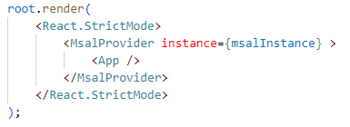
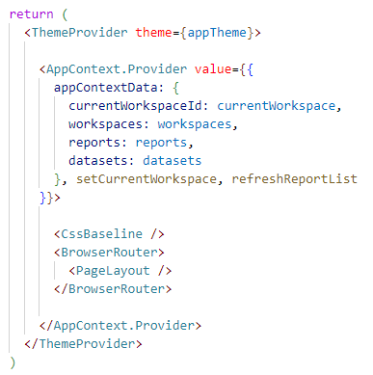
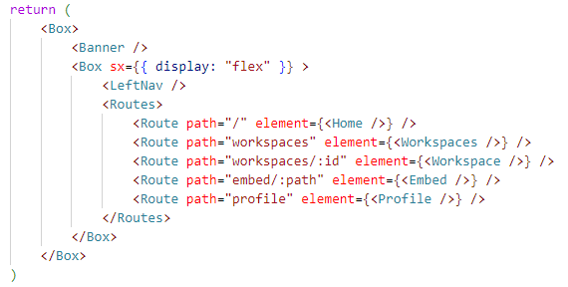
Top-level Component Hierarchy
Support for MSAL, Themes, React Router and a custom Application Context
index.tsc
app.tsc
pagelayout.tsc

Slide 26
Summary
Modern React Primer
Building a User Interface using Material UI
Authenticating Users with MSAL
Calling the Power BI REST API
Managing Application State using Context

Slide 27
Microsoft Power BI
Questions?

Slide 28
xxx
Every Azure Function provides Run method
Run method is executed when trigger by Azure Function runtime

Slide 29

ProcessDataFileUpload Demo Architecture
Function App
Azure Storage Account
ProcessDataFileUpload
Power BI Service
Storage container: salesdata
Target Workspace

